Slide 1
UML (Unified Modeling Language) Diagrams
Software Engineering
Neil Toporski

Slide 2
1 Sequence Diagrams
UML Types
UML Sequence Diagrams
How to Make a Sequence Diagram

Slide 3
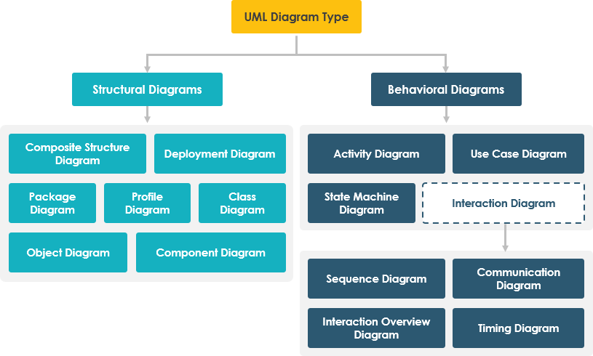

1.1 Unified Modeling Language (UML) Diagram Type

Slide 4
1.2 Sequence Diagrams
Used to model and visualize logic behind a function, operation, or procedure
Show collaborations/interactions between objects
Not so good at precisely defining behaviors
Used for complicated parts of a project
When project design requires input from multiple people
*To view and understand how parts of your system works
“Just trying to communicate”
Notes:
Only shows part of the system

Slide 5
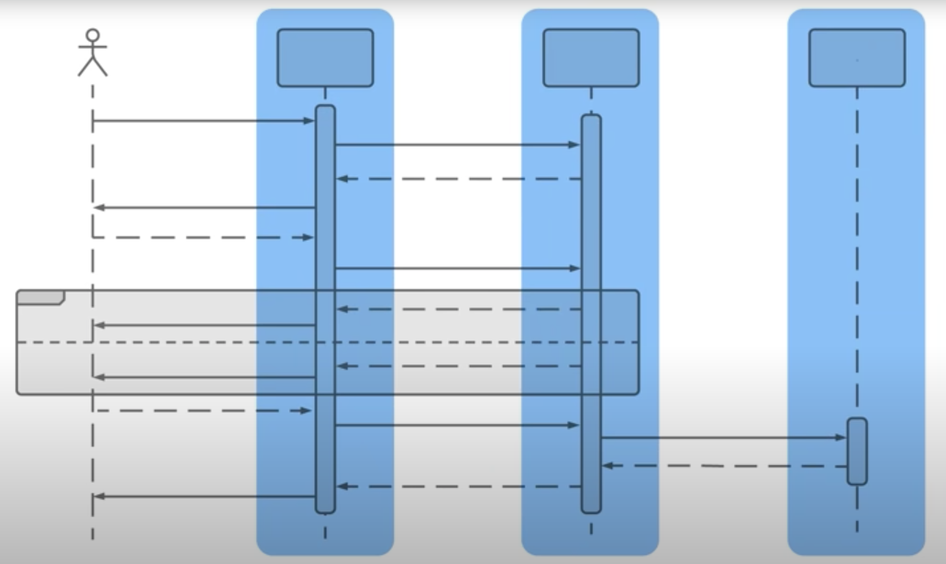
Sequence Diagrams
Shows how objects in a system or classes in code interact with each other.

Slide 6
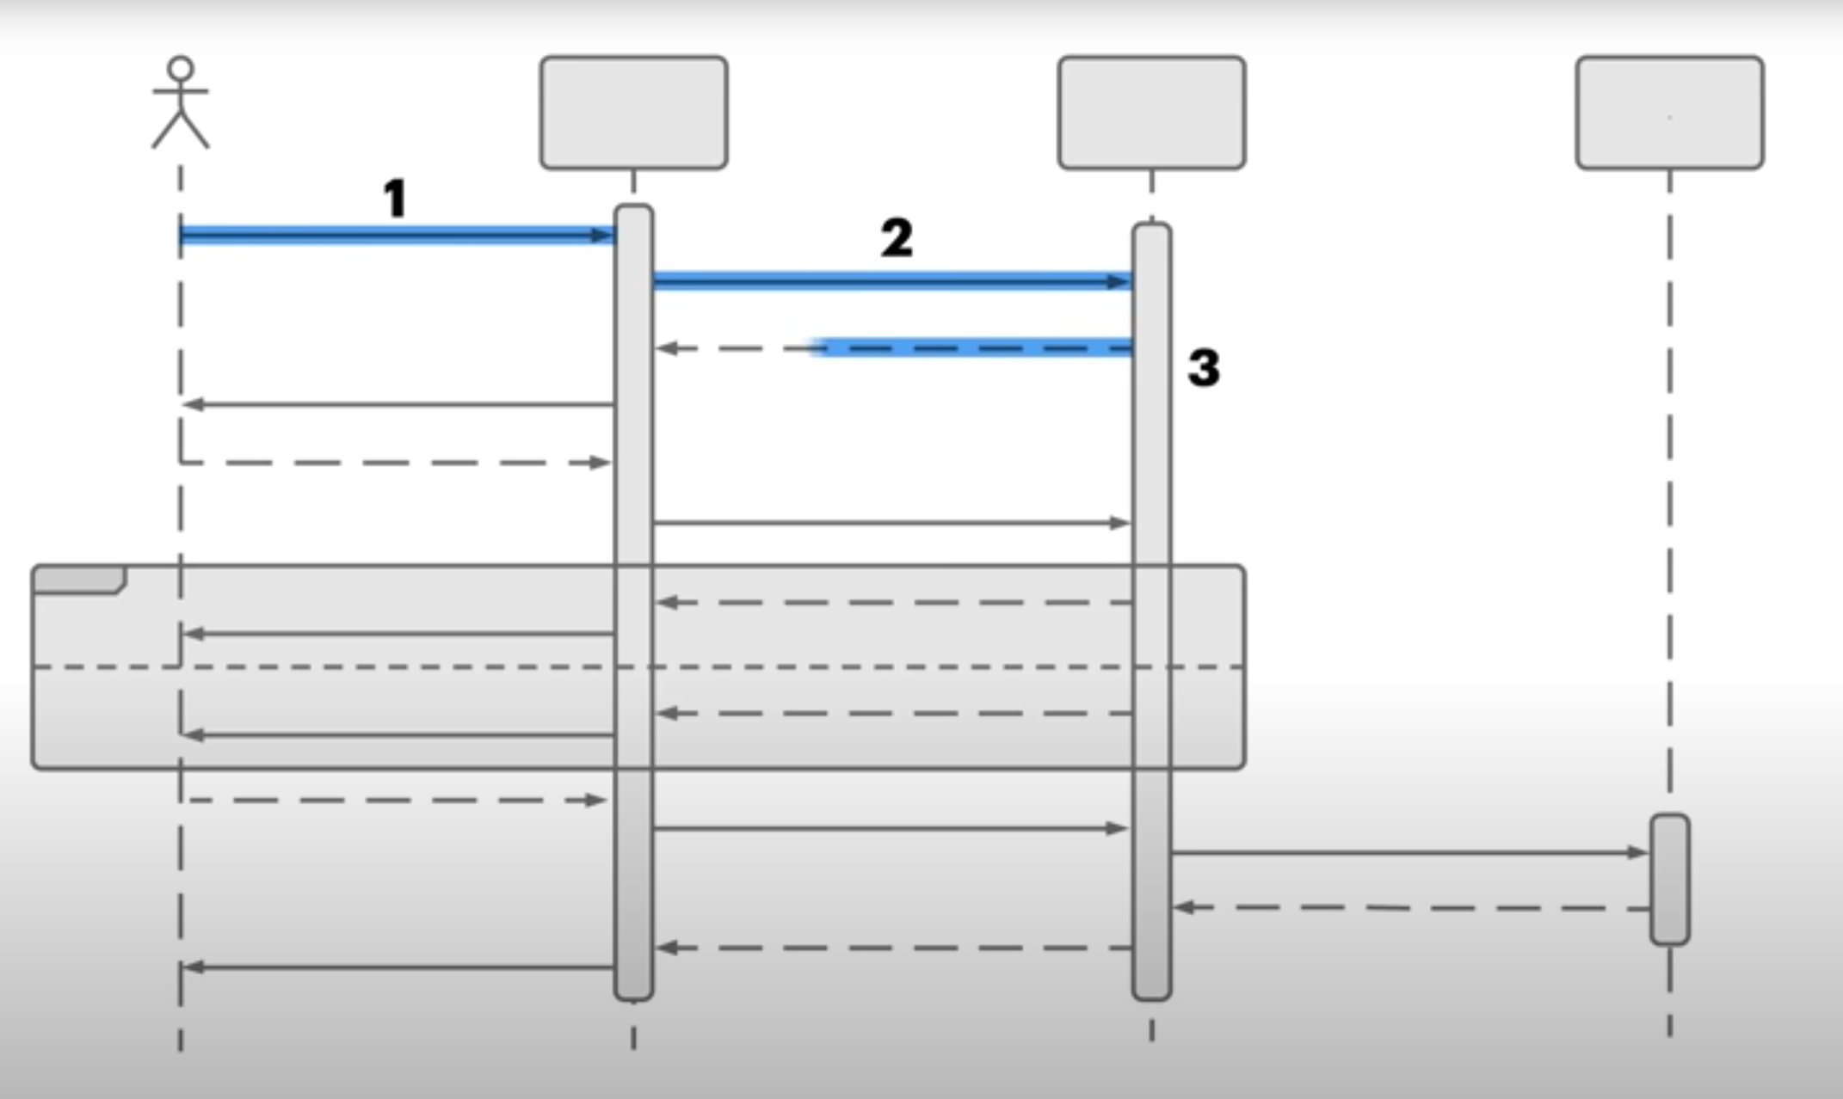
Sequence Diagrams
Diagrams that show interactions in the order that they take place

Slide 7
Sequence Diagrams
Diagrams that show interactions in the order that they take place
Shows the Sequence of Events

Slide 8
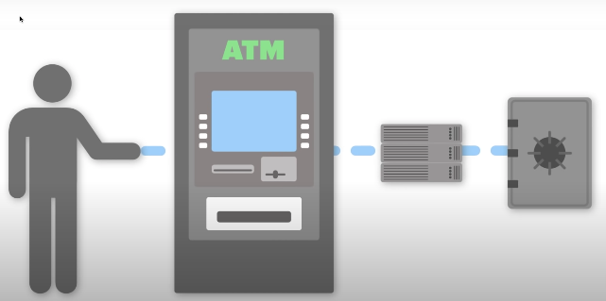
1.3 How to Make a Sequence Diagram
Example: ATM
First define that parts of an ATM and transactions
A person goes to the ATM go get money
The ATM communicates to a bank server
Then the bank account is accessed
Person
ATM
Server
Account

Slide 9
How to Make a Sequence Diagram
Example: ATM
First define that parts of an ATM and transactions
A person goes to the ATM go get money
The ATM communicates to a bank server
Then the bank account is accessed
Person
ATM
Server
Account
ATM System

Slide 10
How to Make a Sequence Diagram
The 3 system items are the Objects
The person is external to the system and called an Actor.
They are always outside the system.
Actor
Objects
Person
ATM
Server
Account
ATM System

Slide 11
How to Make a Sequence Diagram
Actors
Represented by stick figures
Objects
Represented by rectangles

Slide 12
ATM Example: Actor and Objects
ATM
Bank
Server
Customer
Account
Customer

Slide 13
ATM Example: Lifeline
ATM
Bank
Server
Customer
Account
Customer
Lifelines are the vertical dash lines that show the existence of and actor or object over time.
Time increase as you move down the lifeline

Slide 14
ATM Example: Lifeline
ATM
Bank
Server
Customer
Account
Customer
Activations
A thin rectangle on a lifeline) represents the period during which an element is performing an operation.
The top and the bottom of the of the rectangle are aligned with the initiation and the completion time respectively
Notes:
Don’t have to include

Slide 15
ATM Example: Interactions: Messages
ATM
Bank
Server
Customer
Account
Customer
Insert Card
Verify Card

Slide 16
ATM Example: Return Messages
ATM
Bank
Server
Customer
Account
Customer
Insert Card
A Return (or Reply Message: When an object sends a message back.
Represented by a dashed line
From the receiving object back to the requesting object
Verify Card
Card OK

Slide 17
ATM Example: Return Messages
ATM
Bank
Server
Customer
Account
Customer
Insert Card
Request PIN
Not replying to a previous message
Represented by a solid line
Verify Card
Card OK
Request PIN

Slide 18
ATM Example
ATM
Bank
Server
Customer
Account
Customer
Insert Card
Is the Card Valid?
Card is valid
Card is not valid
Verify Card
Card OK
Request PIN

Slide 19
ATM Example
ATM
Bank
Server
Customer
Account
Customer
Insert Card
Is the Card Valid?
Card is valid
Card is not valid
Use Alternative (Alt) fragment to encapsulate
the condition
Verify Card
Alternative
[condition]
Card OK
Request PIN
[else]

Slide 20
Sequence Diagram Fragments
Alternative (alt): Models the conditional (if-then-else) statement. The process flows along either one or the other path. For instance, the customer completing the purchase will either choose to pay by card or by wire transfer, not both.
Option (opt): The option fragment represents a simple choice of behavior between two options. For instance, a customer is presented with the option to choose gift wrapping when completing a purchase. The customer will either select gift wrapping or not.
Loop: Model a repetitive sequence. For instance, a cashier entering items to be purchased into a point-of-sale system or a cash register may need to enter multiple items for each customer before presenting the customer with the total amount and requesting payment. So the entry of items acts as a loop fragment in the process.
Notes:
Return = dotted line

Slide 21
ATM Example
ATM
Bank
Server
Customer
Account
Customer
Insert Card
Is the Card Valid?
Card is valid
Card is not valid
Verify Card
Alternative
[if card is valid]
Card OK
Request PIN
[else]

Slide 22
ATM Example
ATM
Bank
Server
Customer
Account
Customer
Insert Card
Is the Card Valid?
Card is valid
Card is not valid
Verify Card
Alternative
[if card is valid]
Card OK
Request PIN
[else]
Card Invalid
Eject Card

Slide 23
ATM Example
ATM
Bank
Server
Customer
Account
Customer
Insert Card
If Valid
Enter PIN
Same as Card conditional:
Is PIN Valid?
PIN is valid
PIN is not valid
Verify Card
Alternative
[if card is valid]
Card OK
Request PIN
[else]
Card Invalid
Eject Card
PIN Entered
Verify PIN

Slide 24
ATM Example
ATM
Bank
Server
Customer
Account
Customer
Insert Card
If Valid
Enter PIN
Same as Card conditional:
Is PIN Valid?
PIN is valid
PIN is not valid
Verify Card
Alternative
[if card is valid]
Card OK
Request PIN
[else]
Card Invalid
Eject Card
PIN Entered
Verify PIN

Slide 25
Finish Sequence (StarUML)
ATM
Bank
Server
Customer
Account
Customer
Insert Card
If PIN is not valid
Check if sufficient funds
If funds OK
Withdraw amount
Dispense cash
Else
Funds insufficient
Transaction Unsuccessful
Verify Card
Alternative
[if card is valid]
Card OK
Request PIN
[else]
Card Invalid
Eject Card
[if PIN is valid]
PIN Entered
Verify PIN
[else]
Notes:
Could have 3 times loop if PIN fails

Slide 26
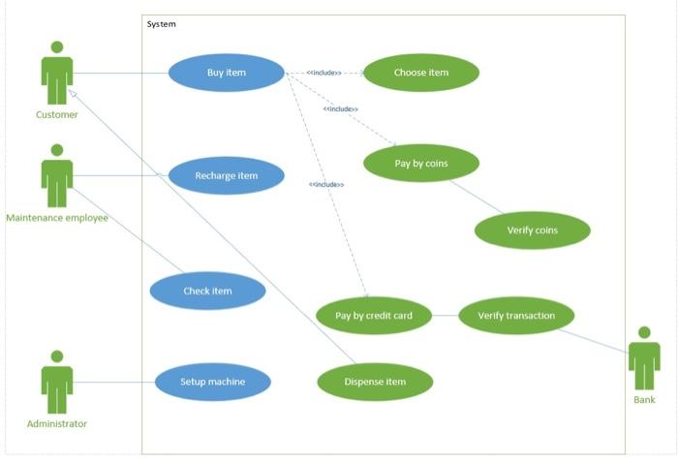
Coffee Vending Machine: Use Case vs Sequence Diagrams

Slide 27
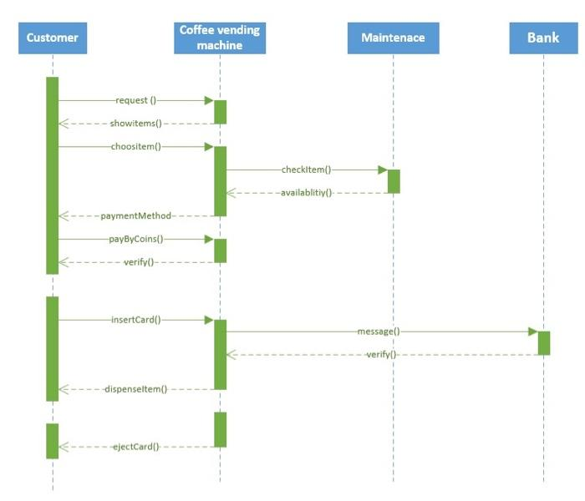
Coffee Vending Machine: Use Case vs Sequence Diagrams

Slide 28
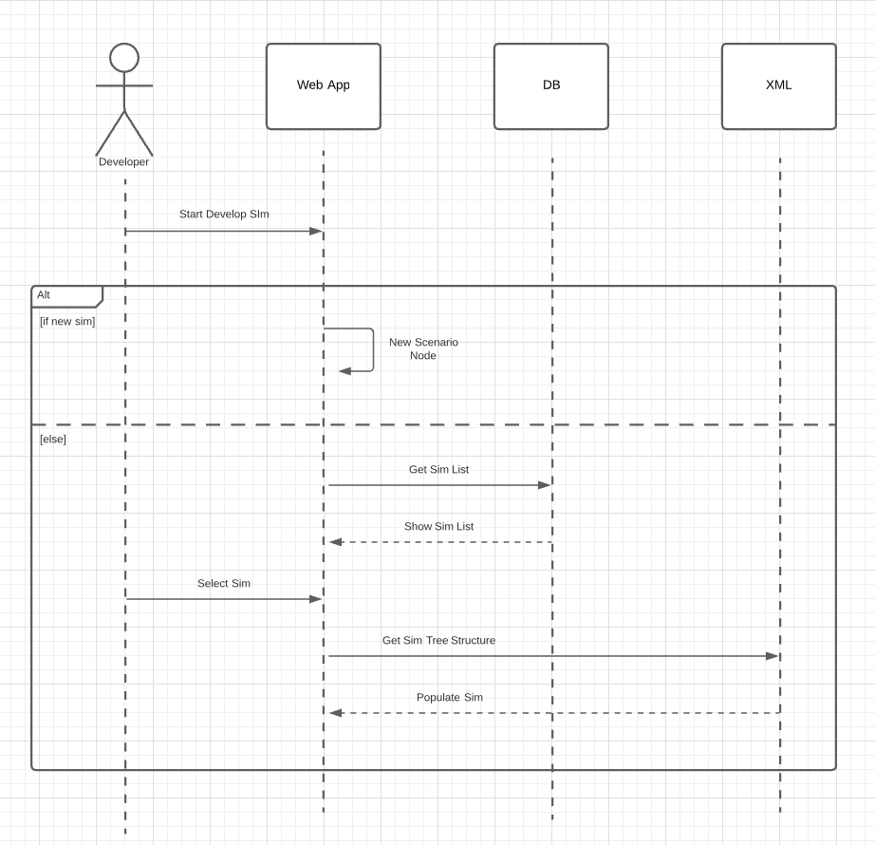
Case Based Scenario
Notes:
Make a new one or open up an existing scenario

Slide 29
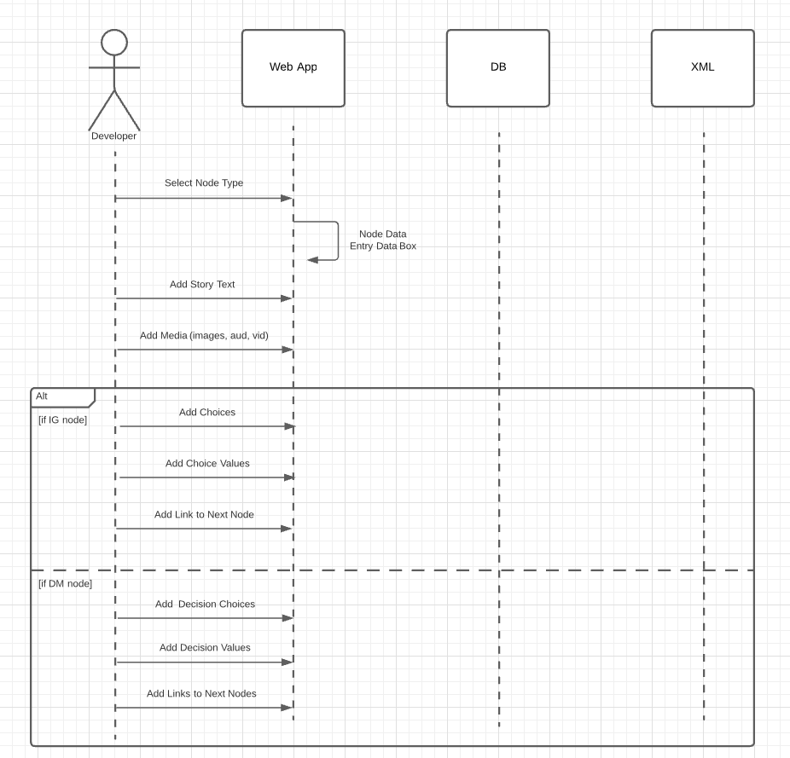
Case Based Scenario
Notes:
Make a choice between IG or DM mode
Circle is to dig down deeper

Slide 30
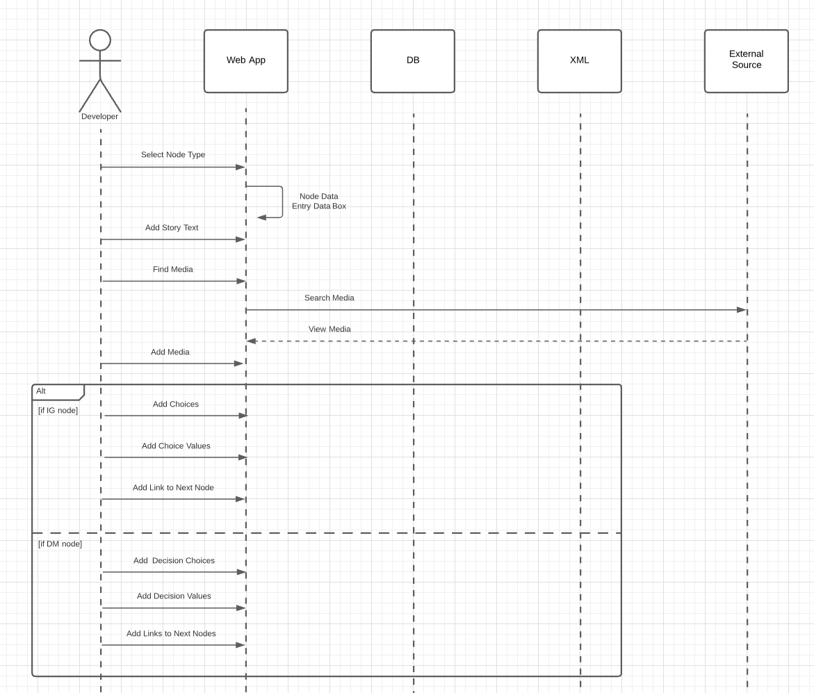
Case Based Scenario

